Slide 1
Simplex Method Graphical Demo

Slide 2
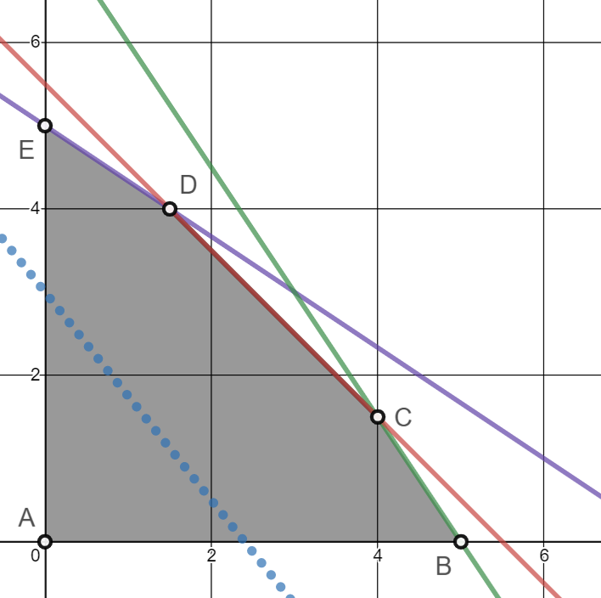
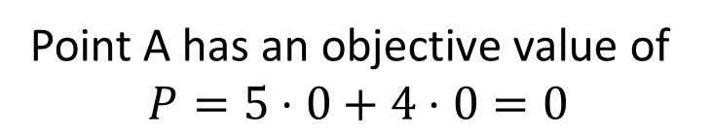
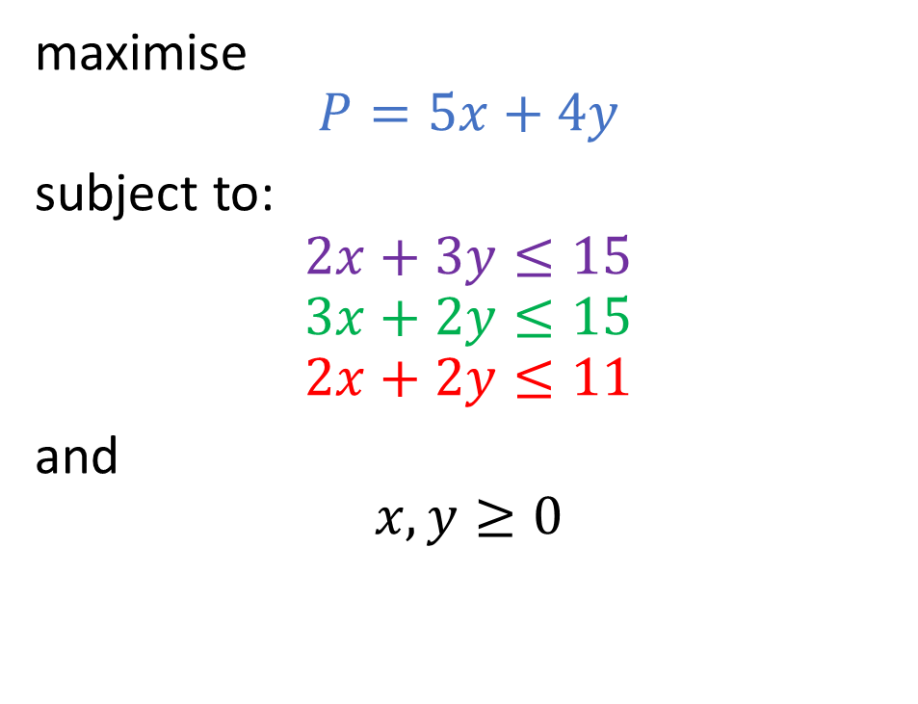

maximise
$$P=5x+4y$$
subject to:
$$2x+3y≤15 \\ 3x+2y≤15 \\ 2x+2y≤11$$
and
$$x,y≥0$$
Point A has an objective value of
$$P=5⋅0+4⋅0=0$$
$$(0,0)$$

Slide 3
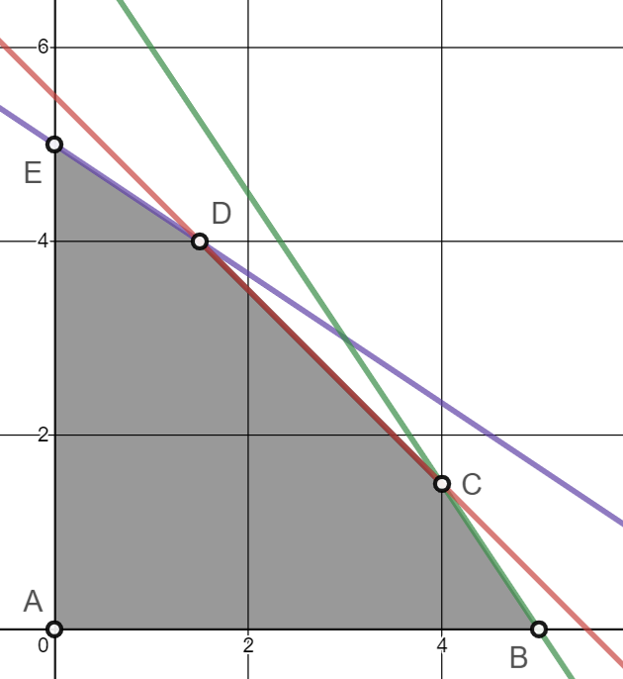

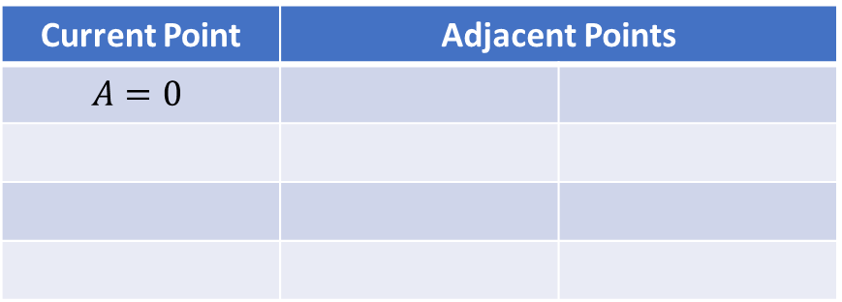
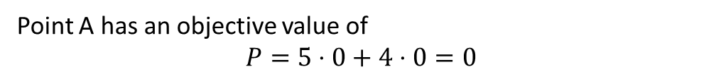
$$P=5x+4y$$
Current Point | Adjacent Points
$$A=0$$
Point A has an objective value of
$$P=5⋅0+4⋅0=0$$
$$(0,0)$$

Slide 4

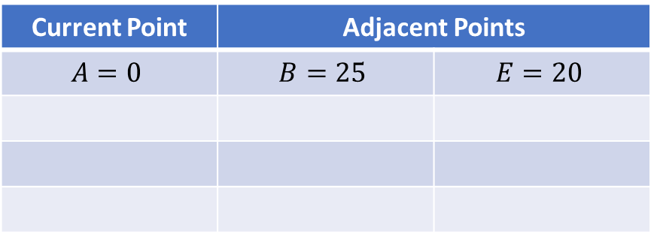
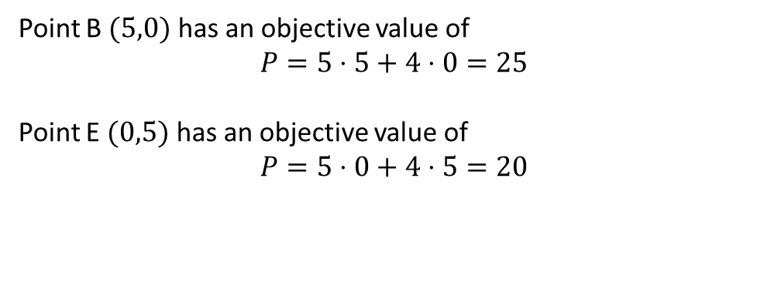

$$P=5x+4y$$
Current Point | Adjacent Points
$$A=0$$ | $$B=25$$ | $$E=20$$
$$(0,5)$$
Point B $(5,0)$ has an objective value of
$$P=5⋅5+4⋅0=25$$
Point E $(0,5)$ has an objective value of
$$P=5⋅0+4⋅5=20$$
$$(5,0)$$

Slide 5
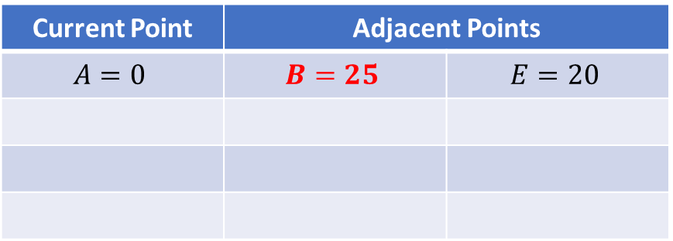
$$P=5x+4y$$
Current Point | Adjacent Points
$$A=0$$ | $$B=25$$ | $$E=20$$
Choose B to move to!

Slide 6
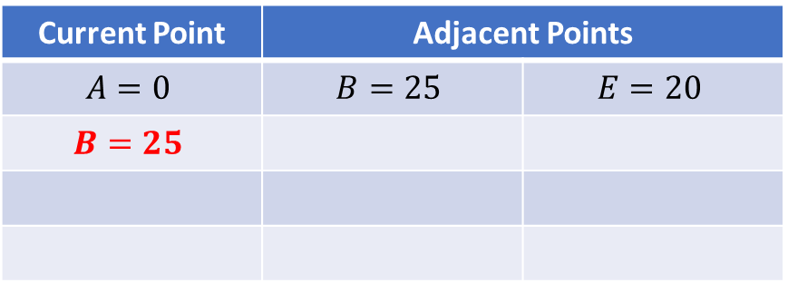
$$P=5x+4y$$
Current Point | Adjacent Points
$$A=0$$ | $$B=25$$ | $$E=20$$
$$B=25$$

Slide 7
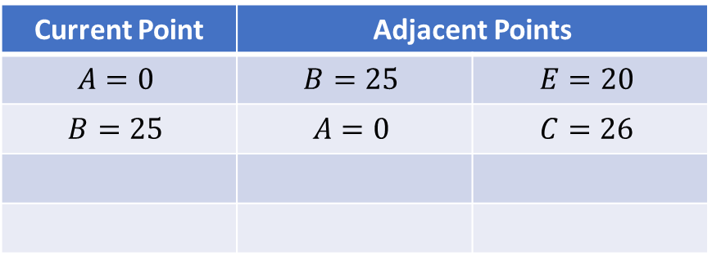
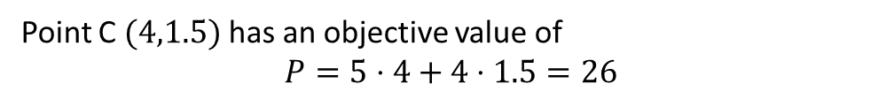

$$P=5x+4y$$
Current Point | Adjacent Points
$$A=0$$ | $$B=25$$ | $$E=20$$
$$B=25$$ | $$A=0$$ | $$C=26$$
$$(4,1.5)$$
Point C $(4,1.5)$ has an objective value of
$$P=5⋅4+4⋅1.5=26$$

Slide 8
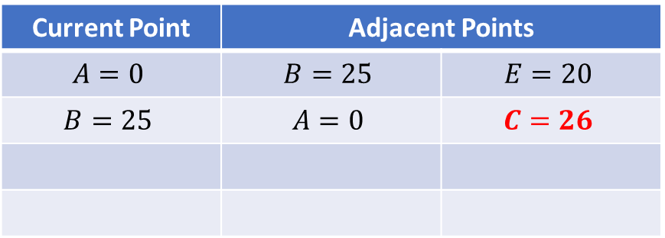
$$P=5x+4y$$
Current Point | Adjacent Points
$$A=0$$ | $$B=25$$ | $$E=20$$
$$B=25$$ | $$A=0$$ | $$C=26$$
Choose C to move to!

Slide 9
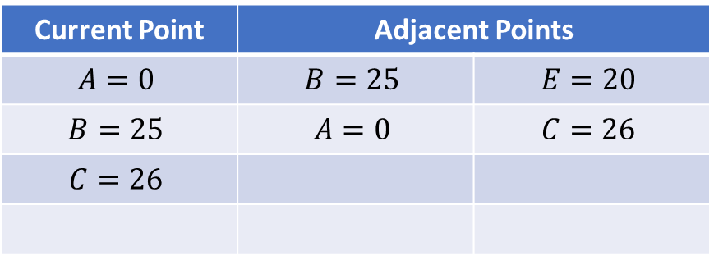
$$P=5x+4y$$
Current Point | Adjacent Points
$$A=0$$ | $$B=25$$ | $$E=20$$
$$B=25$$ | $$A=0$$ | $$C=26$$
$$C=26$$

Slide 10
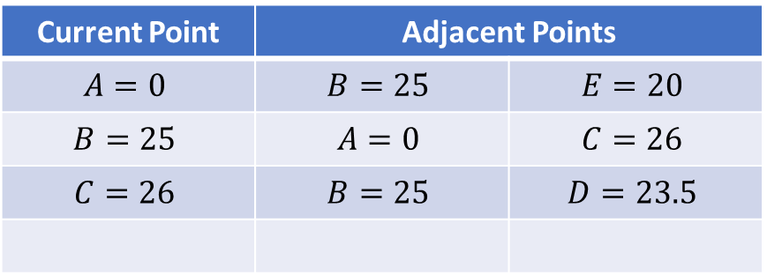
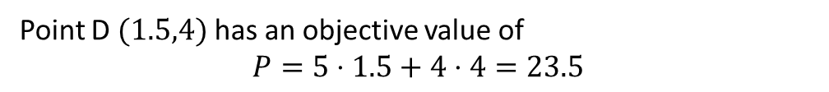

$$P=5x+4y$$
Current Point | Adjacent Points
$$A=0$$ | $$B=25$$ | $$E=20$$
$$B=25$$ | $$A=0$$ | $$C=26$$
$$C=26$$ | $$B=25$$ | $$D=23.5$$
$$(1.5,4)$$
Point D $(1.5,4)$ has an objective value of
$$P=5⋅1.5+4⋅4=23.5$$

Slide 11
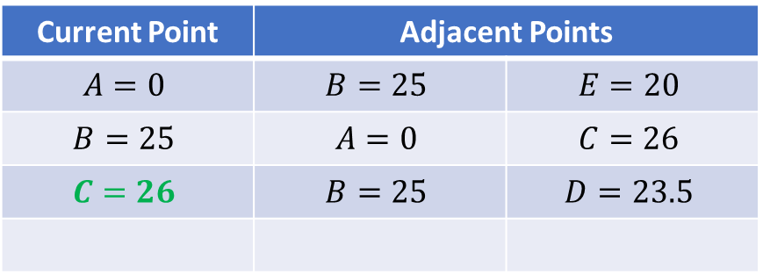
$$P=5x+4y$$
Current Point | Adjacent Points
$$A=0$$ | $$B=25$$ | $$E=20$$
$$B=25$$ | $$A=0$$ | $$C=26$$
$$C=26$$ | $$B=25$$ | $$D=23.5$$
Cannot improve, optimal solution at C!

Slide 12
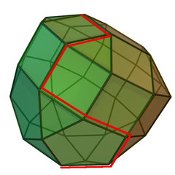
Higher dimensions

